Slide 1
Spain Electricity Shortfall Solution
Presented by: Skyscraper Solutions
Presentation date: 05 March 2022

Slide 2






THE TEAM
Ebere Ezeudemba
Bidemi Dairo
Oluwaleke Oni
Ibrahim David
Stanford GIbson
Notes:
Good day, I’m Stanford Gibson, a Data Scientist from Skyscraper Solutions.
I’m very excited to present to you with our solution, but before I do that let me introduce the rest of the team.
I’m joined by Ibrahim David, Bidemi Dairo, Ebere Ezeudemba and Oluwaleke Oni. Next I’ll take you through the agenda.

Slide 3
AGENDA
Purpose
Exploratory Data Analysis
Data Engineering
Model Building and Selection
Conclusion
Notes:
As part of this presentation, we’ll discuss:
Purpose
Exploratory Data Analysis
Data Engineering
Model Building and Selection
Conclusion

Slide 4
Purpose
1
Spain Electricity Shortfall Solution
Notes:
Let’s look out our purpose.

Slide 5
Global Energy Shortage
Unsustainable use of non-renewable sources of energy
Notes:
I’m sure you’d agree with me, that in all countries, the supply of electricity plays a large role in the livelihood of its citizens.
However, events such as global warming has shown that using of purely non-renewable sources is not sustainable.

Slide 6






THE PROBLEM
THE SOLUTION
Notes:
The problem is that the use of fossil fuels, such as coal, oil and natural gas is severely damaging our environment. Causing local pollution where they’re produced and used, and their ongoing use is causing lasting harm to the climate of our entire planet such as the greenhouse gases causing global warming.
Whereas renewable sources such solar, wind and hydroelectric energy generate no emissions, thereby reducing pollutants in the air and water. Switching to renewables requires far less investment as opposed to building new coal or nuclear power plants.
Using renewable energy creates proven environmental, economic and even human health benefits. So why are we here and how does it relate to Spain?

Slide 7
Spain
To create a model which predicts the shortfall between Spain’s renewable and fossil fuel energy generation sources.
Notes:
The Government of Spain is considering expanding its renewable energy resource infrastructure investments.So they’ve been tracking the different energy sources available within their country.
As such, they require information on the trends and patterns of the country's renewable sources and fossil fuel energy generation capacity.
Let’s look at the data that was supplied.

Slide 8

THE DATA
BILBAO
Categories include:
Wind speed & wind degree
Rain- and snowfall
Humidity
Cloud cover
Air pressure
Temperature
BARCELONA
MADRID
VALENCIA
SEVILLE
Notes:
This dataset contains information about the weather conditions in various Spanish cities for the time of 2015-2017. These cities include;
Madrid
Valencia
Seville
Bilbao
Barcelona
The weather categories, used as predictor variables, in the test and train data-sets includes:
wind_speed
wind_degree
rain_1h
rain_3h
humidity
clouds_all
pressure
Snow_3h
Temperature
The train dataset also has information about the three hourly load shortfalls for the same period.
This shortfall is the difference between the energy generated by means of fossil fuels and renewable sources.
Next we’ll look at the Process we followed to derive our proposed solution.

Slide 9
DATA SCIENCE PROCESS
O
OBTAIN: Gathered data
S
SCRUB: Cleaned the data
E
EXPLORE: Pattern and trend discovery
M
MODEL: Model construction
N
INTERPRET: Put the results into good use.
Notes:
The process we followed can be broken into five steps, during which, we:
OBTAINED data from relevant sources which in this case was Kaggle.
Thereafter we CLEANED the data to formats that the machine understands.
This allowed us to EXPLORE the data, looking significant patterns and trends using statistical methods.
Once we found these trends and patterns we CONSTRUCTED various models to predict and forecast.
Finally, we INTERPRETED the results and created our final solution.
Next I’ll hand over to Ibrahim to take us through the Exploratory Data Analysis phase.

Slide 10
Exploratory Data Analysis
2
Spain Electricity Shortfall Solution

Slide 11
8763 rows and 49 features
2068 missing values
Time series values
Started with:
We found:
Of interest:
Notes:
From the information provided, the dataset has 8763 rows and 49 features.
There were two categorical variables, while the remaining 47 features were numeric. Because regression models can only be built using numerical data, we must ensure that our whole data frame conforms to this rule. We must convert all categorical data into numeric through a process known as Dummy Variable Encoding.
We had a rather clean dataset, except for the column titled Valencia_pressure which has 2068 empty rows. Such a problem will halt any modeling efforts we apply because no model can be trained on blank data points. We will therefore fill in our missing values, being numerical, with the median value.

Slide 12
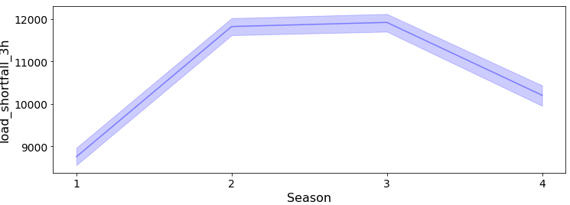
SEASON
Autumn & Winter
Spring
Summer
x
Notes:
Usina line graph, we discovered that the shortfall changes with the seasons.
From the plot, we can observe that load_shortfall rises throughout Spring and reaches a plateau during Summer. It then begins a gradual descent through Autumn and into Winter.

Slide 13
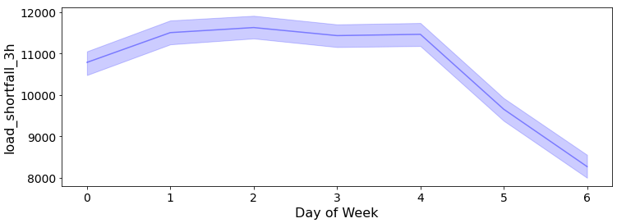
DAY OF WEEK
x
Weekday
Weekend
Notes:
Furthermore, from the Line Graph, some interesting observations can be made.
We noted that the shortfall decreases from Friday into the weekend, Saturday and Sunday.
Monday, identified as 0, is the first day of the week

Slide 14
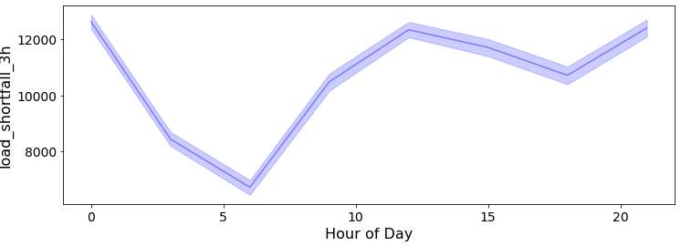
HOUR OF DAY
12AM - 6AM
x
Notes:
We can observe that the load shortfall decreases between 12AM (Midnight) and 6AM
We should conclude on the main relationships observed above between time and load shortfall.

Slide 15
Data Engineering
3
Spain Electricity Shortfall Solution

Slide 16
DATA ENGINEERING
Redundant info
'Unnamed: 0'
Missing values
'Valencia_pressure'
Median
SCALED
Time related features
hour
weekday
week of year
year
Convert categorical data into dummies
[Valencia_wind_deg], [Seville_pressure]
time related features
day
day of year
month
seasons
Notes:
Redundant info
The first step in cleaning our data will be to remove columns that we deem unnecessary. In our case, the second column of our DataSet, Unnamed: 0 does not actually contribute any real observations to the dataset.
Time related features
After established that there have been valuable insights from the EDA's time-related plots, we need to create these features. We anticipate that by adding them into our dataframe, the predictive accuracy of our models later on will be greatly enhanced
Empty values
Among our earlier observations, we discovered that the column, Valencia_pressure is missing some of its values. This problem will hinder the process of model building. To resolve this we will use data imputation to add median value to empty values.
Convert categorical data
We need to convert all our categorical columns/variables into numerical because we plan to use regression models which reject non-numerical data.
Next we scaled the data using the StandardScaler() from sklearn… briefly explain what the scaling achieves

Slide 17
Model Building and Selection
4
Spain Electricity Shortfall Solution

Slide 18
MODEL BUILDING
The following models were built:
Support Vector Regression
Decision Tree Regression
Random Forest Regression
Lasso Regression
Ridge Regression
Notes:
Discuss why regression was selected - prediction of the load_shortfall.
These are all models that work well with features that have no linearity with the target variable.
We built the following 5 models, utilising sklearn’s train-test split as well as hyperparameter tuning.
We need to add a brief explanation of each. With key differences.
SVR: The algorithm acknowledges the presence of non-linearity in the data.
Decision Tree: Good algo for both classification and regression problems. The nodes represents the features, the branches represent the decision rules and leaves represent the outcome.
Random Forest: Ensemble method that combines predictions from multiple decision trees.
Lasso: Adv - It performs both variable selection and regularisation so that the accuracy of the model is enhanced. Here we have many features.
Ridge: It’s a method model tuning that’s used to analyze data that has multicollinearity problems.

Slide 19
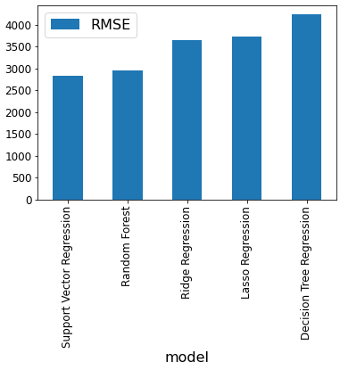
MODEL COMPARISON
Notes:
MSE is a performance metric used to assess the ability of the model to predict unseen data.
It considers the difference between the predicted outcome and the actual outcome.
From the graph we see that SVR has the lowest MSE. Indicating that it has a higher predictive accuracy.

Slide 20
Conclusion
5
Spain Electricity Shortfall Solution

Slide 21
Model selected
Support Vector Regression
Benefits
The optimal use of fossil fuel and renewable energy sources
API link: http://34.243.175.121:5000/api_v0.1
Notes:
The Support Vector Regression Model was selected as it was the best performing model. It produced a lower RMSE (Root Mean Square Error) value of 2829.730672, resulting in a higher accuracy.
By being able to predict future load shortfalls with a high degree of accuracy, will greatly allow the Government of Spain to effectively manage energy supply to cater to its domestic needs and offset the use of fossil fuel with renewable energy sources. That means a lower electricity price, and that has impacts on everything in the economy. A lower electricity price reduces the cost of production, and increases profit.

Slide 22
THANKS!

